Slide 1
User data input through Forms

Slide 2
Forms: how they work
We need to know..
How forms work.
How to write forms in XHTML.
How to access the data in PHP.

Slide 3


How forms work
HTML FORM REQUEST AND RESPONSE
User requests a particular URL
HTML Page supplied with Form
User fills in form and submits.
Another URL is requested and the
Form data is sent to this page either in
URL or as a separate piece of data.
User
Web Server
HTML Response

Slide 4
XHTML Form
The form is enclosed in form tags..
<form action="path/to/submit/page"
method="get">
<!–- form contents -->
</form>

Slide 5
Form tags
Action :it is the page that the form should submit its data to.
Method: this form method by which the form data is submitted. The option are either get or post. If the method is get the data is passed in the url string, if the method is post it is passed as a separate file.
Enctype:this determines the mechanism used to encode the form contents.
Name: this is name of form used in scripts like java.
Target : this is the target frame where the response page will show up.in target the URL need to pass where the response will be sent.

Slide 6
Form fields: text input
Use a text input within form tags for a single line freeform text input.
<label for="fn">First Name</label>
<input type="text"
name="firstname"
id="fn"
size="20"/>

Slide 7
Form tags
name: is the name of the field. You will use this name in PHP to access the data.
id: is label reference string – this should be the same as that referenced in the <label> tag.
Size:is the length of the displayed text box (number of characters).
Maxsize :determines the maximum number of characters that the field will accept.
Value : this will display its contents as default value.

Slide 8
Form fields: password input
Use a starred text input for passwords.
<label for="pw">Password</label>
<input type="password"
name="passwd"
id="pw"
size="20"/>

Slide 9
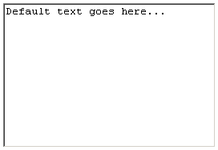
Form fields: text input
If you need more than 1 line to enter data, use a textarea.
<label for="desc">Description</label>
<textarea name="description"
id="desc"
rows="10" cols="30">
Default text goes here…
</textarea>

Slide 10
Form fields: text area
Name: is the name of the field. You will use this name in PHP to access the data.
Id: is label reference string – this should be the same as that referenced in the <label> tag.
Rows: cols :it is the size of the displayed text box for now of rows and cols.
Wrap : default to OFF. You should set wrap to “VIRTUAL” or “PHYSICAL” so that the text wraps in the browser display as the surfer types.

Slide 11
Form fields: drop down
<label for="tn">Where do you live?</label>
<select name="town" id="tn">
<option value="swindon">Swindon</option>
<option value="london"
selected="selected">London</option>
<option value="bristol">Bristol</option>
</select>

Slide 12
Form fields: drop down
name: is the name of the field.
id: is label reference string.
<option value: is the actual data sent back to PHP if the option is selected.
<option>…</option> is the value displayed to the user.
selected="selected" this option is selected by default.

Slide 13
Form fields: radio buttons
<input type="radio"
name="age"
id="u30"
checked="checked"
value="Under30" />
<label for="u30">Under 30</label>
<br />
<input type="radio"
name="age"
id="thirty40"
value="30to40" />
<label for="thirty40">30 to 40</label>

Slide 14
Form fields: radio buttons
name: is the name of the field. All radio boxes with the same name are grouped with only one selectable at a time.
id: is label reference string.
value: is the actual data sent back to PHP if the option is selected.
checked="checked" this option is selected by default.

Slide 15
Form fields: check boxes
What colours do you like?<br />
<input type="checkbox"
name="colour[]"
id="r"
checked="checked"
value="red" />
<label for="r">Red</label>
<br />
<input type="checkbox"
name="colour[]"
id="b"
value="blue" />
<label for="b">Blue</label>

Slide 16
Form fields: check boxes
name: is the name of the field. Multiple checkboxes can be selected, so if the button are given the same name, they will overwrite previous values. The exception is if the name is given with square brackets – an array is returned to PHP.
id: is label reference string.
value: is the actual data sent back to PHP if the option is selected.
checked="checked" this option is selected by default.

Slide 17
Hidden Fields
<input type="hidden"
name="hidden_value"
value="My Hidden Value" />
name: is the name of the field.
value: is the actual data sent back to PHP.

Slide 18
Submit button..
A submit button for the form can be created with the code:
<input type="submit"
name="submit"
value="Submit" />

Slide 19
Fieldset
all inputs must be grouped within the form into fieldsets. These represent logical divisions through larger forms. For short forms, all inputs are contained in a single fieldset.
<form>
<fieldset>
<input … />
<input … />
</fieldset>
<fieldset>
<input … />
<input … />
</fieldset>
</form>

Slide 20
In PHP…
The form variables are available to PHP in the page to which they have been submitted.
The variables are available in two superglobal arrays created by PHP called $_POST and $_GET.

Slide 21
Access data
Access submitted data in the relevant array for the submission type, using the input name as a key.
<form action="path/to/submit/page"
method="get">
<input type="text" name="email">
</form>
$email = $_GET[‘email’];

Slide 22
A warning..
NEVER TRUST USER INPUT
Always check what has been input.
Validation can be undertaken using Regular expressions or in-built PHP functions.

Slide 23
A useful tip..
I find that storing the validated data in a different array to the original useful.
I often name this array ‘clean’ or something similarly intuitive.
I then *only* work with the data in $clean, and never refer to $_POST/$_GET again.

Slide 24
Example
$clean = array();
if (ctype_alnum($_POST['username']))
{
$clean['username'] = $_POST['username'];
}

Slide 25
Filter example
$clean = array();
if (ctype_alnum($_POST['username']))
{
$clean['username'] = $_POST['username'];
}
$clean = array();
Initialise an array to store filtered data.

Slide 26
Filter example
$clean = array();
if (ctype_alnum($_POST['username']))
{
$clean['username'] = $_POST['username'];
}
if (ctype_alnum($_POST['username']))
Inspect username to make sure that it is alphanumeric.

Slide 27
Filter example
$clean = array();
if (ctype_alnum($_POST['username']))
{
$clean['username'] = $_POST['username'];
}
$clean['username'] = $_POST['username'];
If it is, store it in the array.

Slide 28
Is it submitted?
We also need to check before accessing data to see if the data is submitted, use isset() function.
if (isset($_POST[‘username’])) {
// perform validation
}

Slide 29
Submitting Form values
We can submit form elements values using $_GET & $_POST Methods.
Here form elements can be any from Text Box, Text Area, List Box, Check Box, Radio Box, Hidden Fields etc. with submitting using submit button.
When form is submitted script defined in form action parameter of form tag will be called and super global array is set (based on POST or GET Method) defined in form method parameter.
Super global array have collection of all form element values accessible in PHP Script called with action parameter.

Slide 30
Submitting Form values
SubmittingForm.php
<html>
<body>
<form action = "SubmitScript.php" method = "POST">
Name: <input type = "text" name = "name" />
Age: <input type = "text" name = "age" />
<input type = "submit" name="SubmitForm"
Value = "Send" />
</form>
</body>
</html>

Slide 31
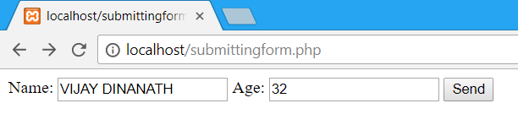
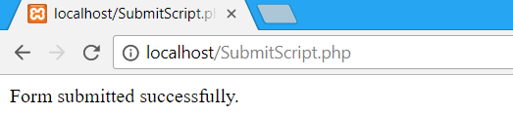
Submitting Form values
Submitscript.php
<?php
if (isset($_POST["SubmitForm"]))
{
echo "Form submitted successfully.";
} Output :
?>

Slide 32
One form, multiple processing
We can create single form having multiple submit buttons for variety of actions to be performed.
For example we are designing any application have multiple functionalities like insert, update, delete and fetch operations for each operation we need to use the separate submit functionality in this situation we need to use multiple submit having separate submit values and in action script we can differentiate all with their submit values and perform operation accordingly.
See example….

Slide 33
PHP 5 Form Handling
The PHP superglobals $_GET and $_POST are used to collect form-data.
When the user fills out the form above and clicks the submit button, the form data is sent for processing to a PHP file named in action. The form data is sent with the HTTP POST or GET method.
There are two ways the browser client can send information to the web server.
    The GET Method
    The POST Method

Slide 34
The GET Method
The GET method sends the encoded user information appended to the page request. The page and the encoded information are separated by the ? character.
Syntax
http://www.test.com/index.htm?name1=value1&name2=value2
The GET method produces a long string that appears in your server logs, in the browser's Location: box.
The GET method is restricted to send up to 1024 characters only.

Slide 35
The GET Method
Never use GET method if you have password or other sensitive information to be sent to the server.
GET can't be used to send binary data, like images or word documents, to the server.
The data sent by GET method can be accessed using QUERY_STRING environment variable.
The PHP provides $_GET associative array to access all the sent information using GET method.

Slide 36

GET Method
GetMethod.html
<html>
<body>
<form action = "GetScript.php" method = "GET">
Name: <input type = "text" name = "name" />
Age: <input type = "text" name = "age" />
<input type = "submit" />
</form> Output
</body>
</html>

Slide 37
GET Method
PHP Script : GetScript.php
<?php
if (isset($_GET["name"]))
{
if( $_GET["name"] || $_GET["age"] ) {
echo "Welcome ". $_GET['name']. "<br />";
echo "You are ". $_GET['age']. " years old.";
exit();
}
}
?>

Slide 38
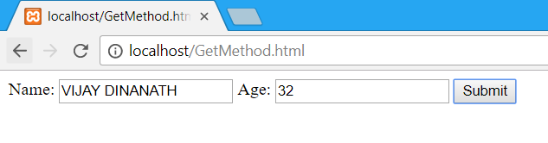
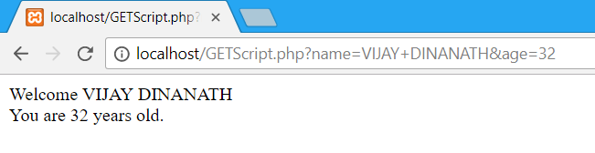
GET Method
Output

Slide 39
POST Method
The POST method transfers information via HTTP headers. The information is encoded as described in case of GET method and put into a header called QUERY_STRING.
The POST method does not have any restriction on data size to be sent.
The POST method can be used to send ASCII as well as binary data.
The data sent by POST method goes through HTTP header so security depends on HTTP protocol. By using Secure HTTP you can make sure that your information is secure.
The PHP provides $_POST associative array to access all the sent information using POST method.

Slide 40
POST Method
PostMethod.html
<html>
<body>
<form action = "PostScript.php" method = "POST">
Name: <input type = "text" name = "name" />
Age: <input type = "text" name = "age" />
<input type = "submit" />
</form>
</body>
</html>

Slide 41
POST Method
PostScript.php
<?php
if (isset($_POST["name"]))
{
if( $_POST["name"] || $_POST["age"] ) {
echo "Welcome ". $_POST['name']. "<br />";
echo "You are ". $_POST['age']. " years old.";
exit();
}
}
?>

Slide 42
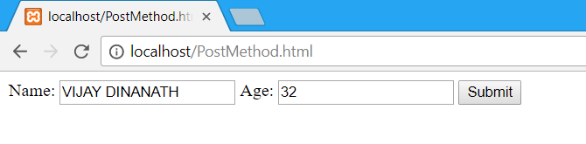
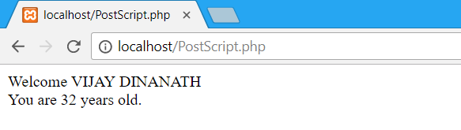
POST Method
Output

Slide 43
The $_REQUEST Variable
The PHP $_REQUEST variable contains the contents of both $_GET, $POST, $_COOKIE.
We will discuss $_COOKIE variable when we will explain cookies.
The PHP $_REQUEST variable can be used to get the result from form data sent with both the GET and POST methods.

Slide 44
The $_REQUEST Variable
GetRequest.php
<html>
<body>
<form action = "ProcessRequest.php" method = “GET">
Name: <input type = "text" name = "name" />
Age: <input type = "text" name = "age" />
<input type = "submit" />
</form>
</body>
</html>

Slide 45
The $_REQUEST Variable
PostRequest.php
<html>
<body>
<form action = "ProcessRequest.php" method = “POST">
Name: <input type = "text" name = "name" />
Age: <input type = "text" name = "age" />
<input type = "submit" />
</form>
</body>
</html>

Slide 46
The $_REQUEST Variable
ProcessRequest.php
<?php
if (isset($_ REQUEST["name"]))
{
if( $_POST["name"] || $_REQUEST["age"] ) {
echo "Welcome ". $_ REQUEST['name']. "<br />";
echo "You are ". $_ REQUEST POST['age']. " years old.";
exit();
}}
?>

Slide 47
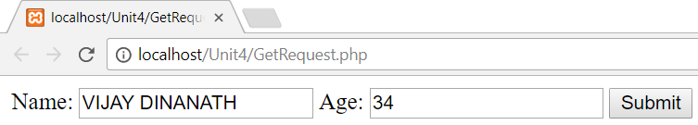
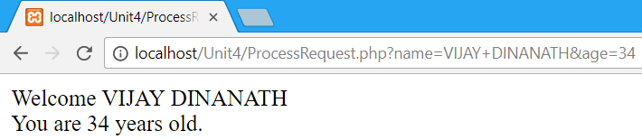
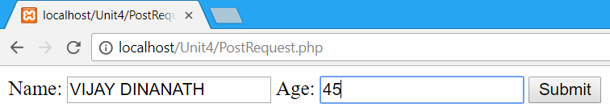
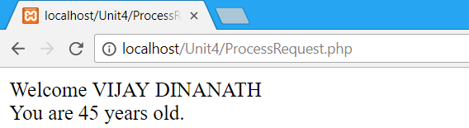
The $_REQUEST Variable Output

Slide 48
Difference between GET & Post
The GET method
It sends encoded user information append to the page request.
The GET method produces a long string that appears in your server logs, in the browser's Location: box.
The GET method is restricted to send upto 1024 characters only.
Never use GET method if you have password or other sensitive information to be sent to the server.
GET can't be used to send binary data, like images or word documents, to the server.
The data sent by GET method can be accessed using QUERY_STRING environment variable.
The PHP provides $_GET associative array to access all the sent information using GET method.

Slide 49
Difference between GET & Post
The POST Method
The POST method transfers information via HTTP headers. The information is encoded as described in case of GET method and put into a header called QUERY_STRING.
The POST method does not have any restriction on data size to be sent.
The POST method can be used to send ASCII as well as binary data.
The data sent by POST method goes through HTTP header so security depends on HTTP protocol. By using Secure HTTP you can make sure that your information is secure.
The PHP provides $_POST associative array to access all the sent information using POST method.

Slide 50
Combining HTML & PHP Codes
The PHP Default variable $_PHP_SELF is used for PHP Script name and when submit form then same PHP Script will be called same page.
We can embed PHP script inside the html pages in action parameter we will give the $_PHP_SELF variable.
See example….

Slide 51
Browser Redirection
The PHP header() function supplies raw HTTP headers to the browser and can be used to redirect it to another location.
The redirection script should be at the very top of the page to prevent any other part of the page from loading.
The target is specified by location: header s the argument to the header() function. After calling this function the exit() function can be used to half parsing of rest of the code.
See Example….

Slide 52
Basics of Cookies
A cookie is often used to identify a user. A cookie is a small file that the server embeds on the user's computer. Each time the same computer requests a page with a browser, it will send the cookie too. With PHP, you can both create and retrieve cookie values.
Cookies are text files stored on the client computer and they are kept of use tracking purpose. PHP transparently supports HTTP cookies.
There are three steps involved in identifying returning users
Server script sends a set of cookies to the browser. For example name, age, or identification number etc.
Browser stores this information on local machine for future use.
When next time browser sends any request to web server then it sends those cookies information to the server and server uses that information to identify the user.

Slide 53
How to create cookies in PHP
Cookie is created using setcookie() function.
Syntax
setcookie(name, value, expire, path, domain, secure, httponly);
Name : This sets the name of the cookie and is stored in an environment variable called HTTP_COOKIE_VARS. This variable is used while accessing cookies
Value : this sets the value in cookies called content of cookie in browser.
Expire :This specify a future time in seconds since 00:00:00 GMT on 1st Jan 1970. After this time cookie will become inaccessible. If this parameter is not set then cookie will automatically expire when the Web Browser is closed.

Slide 54
How to create cookies in PHP
Path − This specifies the directories for which the cookie is valid. A single forward slash character permits the cookie to be valid for all directories.
Domain − This can be used to specify the domain name in very large domains and must contain at least two periods to be valid. All cookies are only valid for the host and domain which created them.
Security − This can be set to 1 to specify that the cookie should only be sent by secure transmission using HTTPS otherwise set to 0 which mean cookie can be sent by regular HTTP.
See Example to set cookie….

Slide 55
How cookies work
Process of writing and reading cookies as follow
A cookie is set in clients browser in HTTP response headers this is achieved using set cookies header.
The server sends one Set-Cookie header for every cookie to be set.
When a browser subsequently requests a page it sends the cookie header containing the name and value of all cookies previously set on the matching domain and path.

Slide 56
Accessing cookies with PHP
PHP provides many ways to access cookies. We will see here two ways to access cookies using $_COOKIE and $HTTP_COOKIE_VARS variables.
$_COOKIE variable we can use to access value with the name of cookie.
For Example we have stored cookie with name “Name” then to access value $_COOKIE[“Name”] will give the value stored in Name cookie.
$_HTTP_COOKIE_VARS variable we can use to access value with the name of cookie.
For example we have stored cookie with name “Name” then to access value $_HTTP_VARS[“Name”] will give the value stored in Name cookie.
See Example….

Slide 57
Checking Cookie set or not
In PHP we can check is cookie set or not using isset() function.
We need to pass cookie variable to isset() function it will return true if cookie variable set with value else false.
For example
  if (isset($_COOKIE[“Name”]))
  echo “My Name is : “ . $_COOKIE[“Name”];
  else
  echo “Cookie not set.”;
  See Example….

Slide 58
Deleting Cookies
To delete cookie we can set again with setcookie() and only name argument means without any value but this is not working well all time so need not to relied on same.
Also we can delete cookie by changing expiry date to past date which already gone. It is the safest way to delete the cookies.
For example
setcookie("name", "Alpesh Thaker", time()-60, "/","", 0);
See example……

Slide 59
Using Cookie Authentication
You want more control over the user login procedure, such as presenting your own login form.
Store authentication status in a cookie or as part of a session. When a user logs in successfully, put their username in a cookie. Also include a hash of the username and a secret word so a user can't just make up an authentication cookie with a username in it.
See Example….

Slide 60
Understanding Session
Session is alternative way to make data accessible across the various pages of an entire website is to use a PHP Session.
A session creates a file in a temporary directory on the server where registered session variables and their values are stored. This data will be available to all pages on the site during that visit.
The location of the temporary file is determined by a setting in the php.ini file called session.save_path. Before using any session variable make sure you have setup this path.

Slide 61
Understanding Session
PHP first creates a unique identifier for that particular session which is a random string of 32 hexadecimal numbers such as 3c7foj34c3jj973hjkop2fc937e3443.
A cookie called PHPSESSID is automatically sent to the user's computer to store unique session identification string.
A file is automatically created on the server in the designated temporary directory and bears the name of the unique identifier prefixed by sess_ ie sess_3c7foj34c3jj973hjkop2fc937e3443.

Slide 62
Understanding Session
When a PHP script wants to retrieve the value from a session variable, PHP automatically gets the unique session identifier string from the PHPSESSID cookie and then looks in its temporary directory for the file bearing that name and a validation can be done by comparing both values.
A session ends when the user loses the browser or after leaving the site, the server will terminate the session after a predetermined period of time, commonly 30 minutes duration.

Slide 63
Starting a PHP Session
Before you can store any information in session variables, you must first start up the session. To begin a new session, simply call the PHP session_start() function. It will create a new session and generate a unique session ID for the user.
The PHP code in the example below simply starts a new session.
<?php
// Starting session
session_start();
?>

Slide 64
Starting a PHP Session
The session_start() function first checks to see if a session already exists by looking for the presence of a session ID. If it finds one, i.e. if the session is already started, it sets up the session variables and if doesn't, it starts a new session by creating a new session ID.
Session variables are stored in associative array called $_SESSION[]. These variables can be accessed during lifetime of a session.
Make use of isset() function to check if session variable is already set or not.
See Example…..

Slide 65
Session Variable
When you want to store user data in a session use the $_SESSION associative array. This is where you both store and retrieve session data. In previous versions of PHP there were other ways to perform this store operation, but it has been updated and this is the correct way to do it.
<?php
session_start();
$_SESSION['views'] = 1; // store session data //retrieve data
echo "Pageviews = ". $_SESSION['views']; ?>

Slide 66
Session Register
For session variable one another method is to use the PHP Session with session_register() function.
Session_register() function takes two arguments first argument is variable name and second one is session variable value to be assigned to session variable.
Session variables accessed by using the variable name as an index key into the $_SESSION array.
The session_is_registered() function can also be used to make sure the variable exists before attempting to read the value is called good practice to develop any application.

Slide 67
Session Register example
PHP Script
<?php
session_start();
$_SESSION["NAME"] = "ALPESH THAKER";
if (session_is_registered('NAME')) {
echo "My Name is : ". $_SESSION["NAME"];
}
?>
Output:
My Name is : ALPESH THAKER

Slide 68
Displaying Entire session variables
We can store different data in session variables.as per our requirement and all variables are stored in $_SESSION global array.
We can access entire array using loop same like we use to access array elements.
See example….

Slide 69
Destroying the session
We can destroy or delete the sessions we can use two different commands.
It is advisable to use these commands in the below sequence to destroy sessions in PHP.
Two commands are as session_unset() and session_destroy().
See Example….

Slide 70
Difference between Cookie & Session
Cookies | Sessions
Cookies are stored in browser as text file format. | Sessions are stored in server side.
It is stored limit amount of data. | It is stored unlimited amount of data
It is only allowing 4kb[4096bytes]. | It is holding the multiple variable in sessions.
It is not holding the multiple variable in cookies. | It is holding the multiple variable in sessions.
we can accessing the cookies values in easily. So it is less secure. | we cannot accessing the session values in easily.So it is more secure.
setting the cookie time to expire the cookie. | using session_destory(), we we will destroyed the sessions.
The setcookie() function must appear BEFORE the <html> tag. | The session_start() function must be the very first thing

Slide 71
Managing user preference with session
Preferencej | Default | Options | Descriptions
Sess_cookie_name | Cl_session | None | The name you want the session cookie saved as.
Sess_expiration | 7200 | None | The number of seconds you would like the session to last. The default value is 2 hour(7200 seconds). If you would like non expiring session set the value to zero:0
Sess_expire_on_close | FALSE | TRUE/FALSE (Boolean) | Weather to cause the session to expire automatically when the browser window is closed.
Sess_encrypt_cookie | FALSE | TRUE/FALSE (Boolean) | Weather to encrypt the session data
Sess_use_database | FALSE | TRUE/FALSE (Boolean) | Weather to save session data to a database. You must create the table before enabling the option.
Sess_table_name | Ci_sessions | Any valid SQL table name | The name of the session database table.

Slide 72
Managing user preference with session
Preference | Default | Options | Descriptions
Sees_time_to_update | 300 | Time in seconds | This option controls how often the session class will regenerate itself and create a new session id.
Sess_match_ip | FALSE | TRUE/FALSE (Boolean) | Weather to match the user’s IP address when reading the session data. Note that some ISPs dynamically changes the IP, So if you will likely to set this to FALSE.
Sess_match_useragent | TRUE | TRUE/FALSE (Boolean) | Weather to match the User agent when reading the session data.

Slide 73
Thank you

